Slide 1

Python Introduction
自動化開發與認證課
David_Zhu
2022/5/10

Slide 2
Directory
Python install for Windows
Visual Studio Code / Anaconda Spyder
Package Install (Pip install)
Python
Common
Data Type
Data Structure (Tuple(),List[], Set{}, dict{})
Flow control
Module
Exception
Object-oriented programming
Class
Encapsulation
Inheritance
Abstract Method
Polymorphism
Reference

Slide 3
Python Install

Slide 4
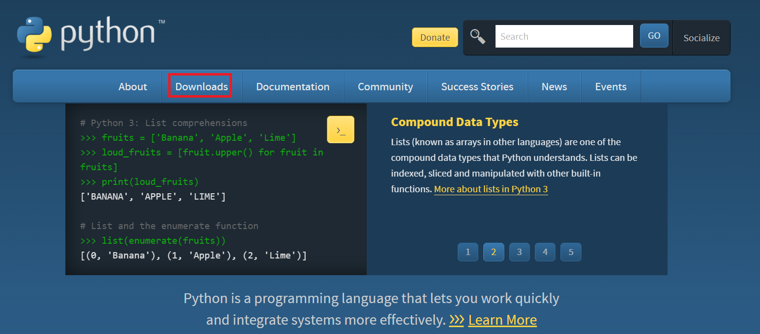
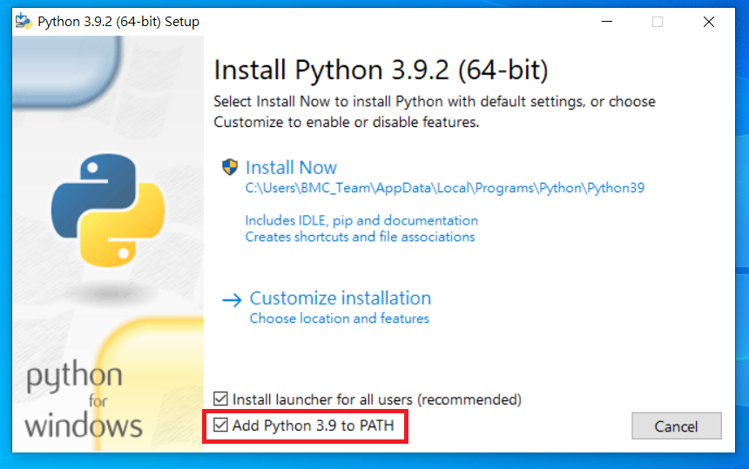
Python Install
Download : https://www.python.org/downloads/

Slide 5
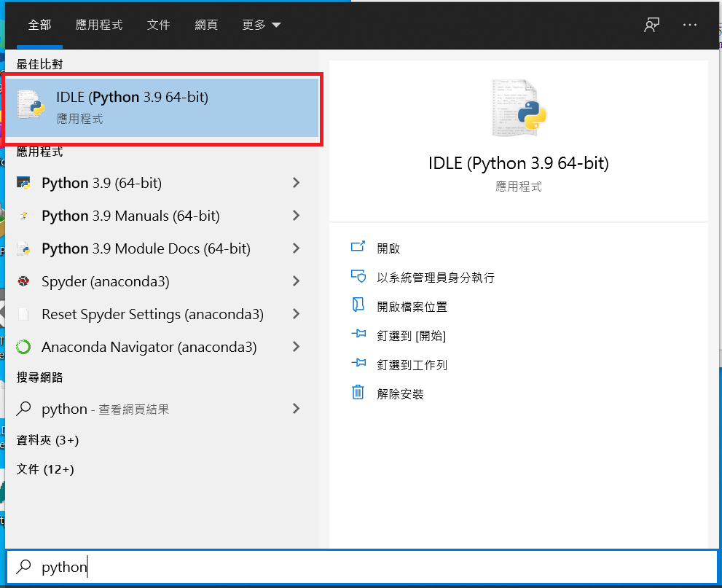
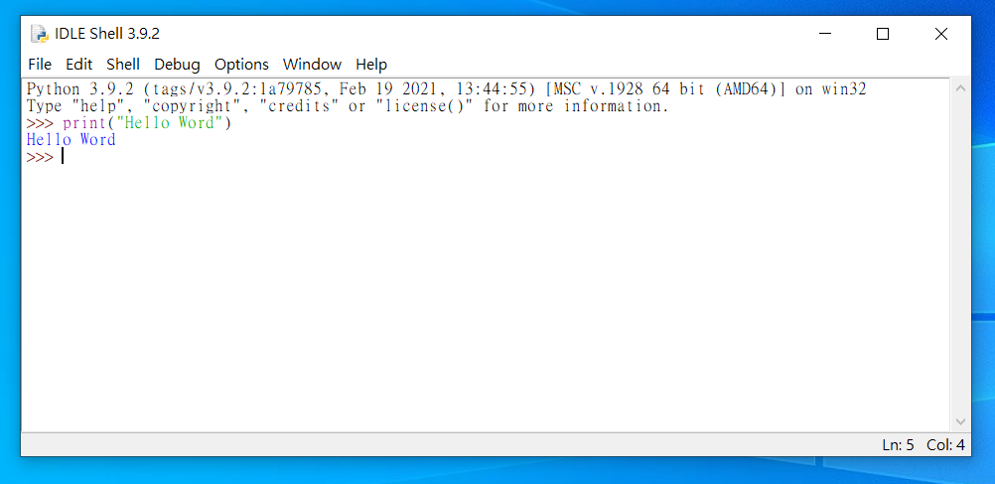
Python Install

Slide 6
Anaconda(Spyder)

Slide 7

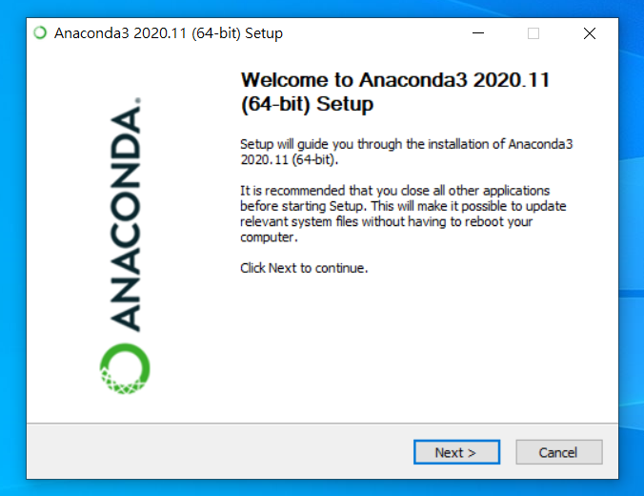
Anaconda (Spyder)
https://www.anaconda.com/products/individual

Slide 8
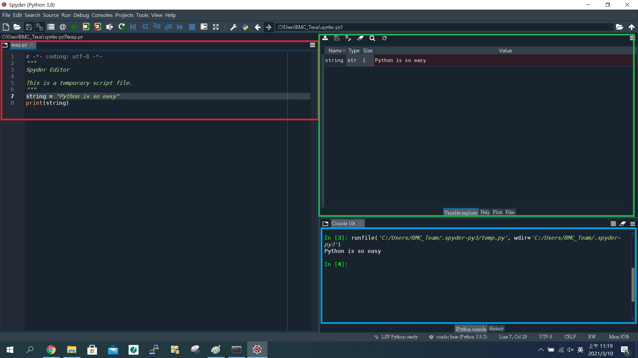
Anaconda (Spyder)
Browse tabs
Variables explorer
Console

Slide 9
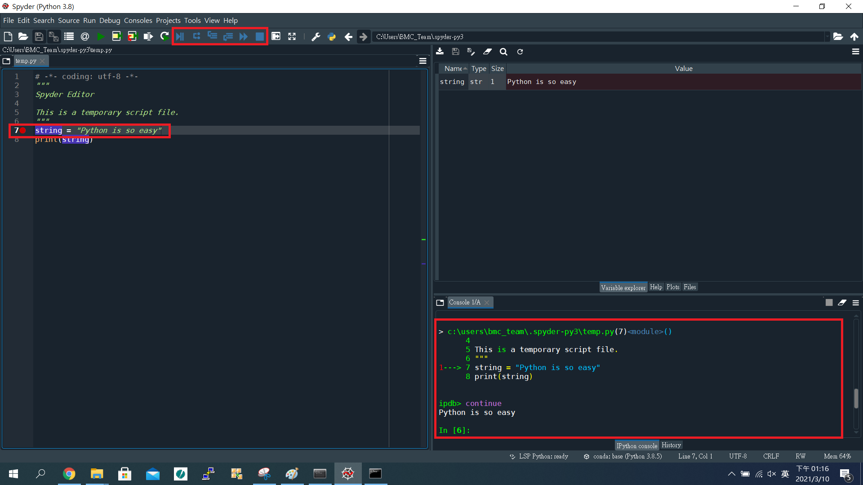
Anaconda (Spyder)
Debug mode
By step to execute
View all of the variables

Slide 10
Visual Studio Code

Slide 11
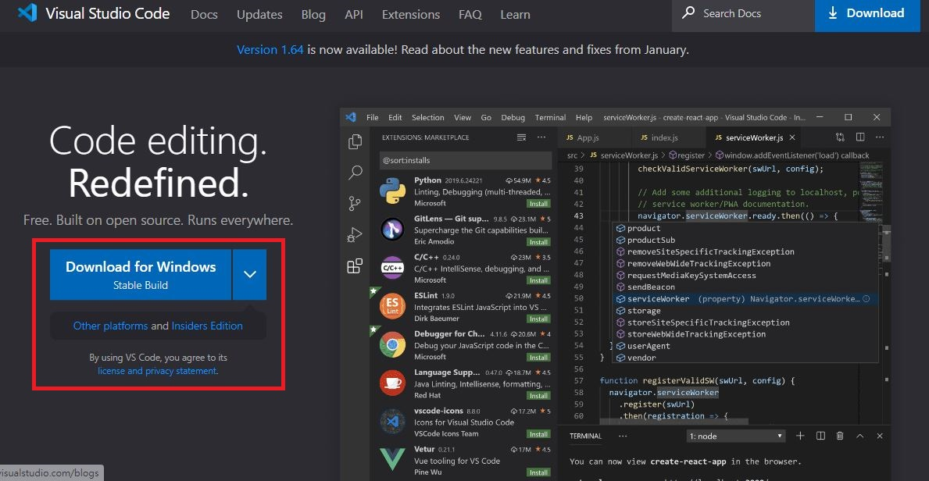
Visual Studio Code
Download : https://code.visualstudio.com/

Slide 12
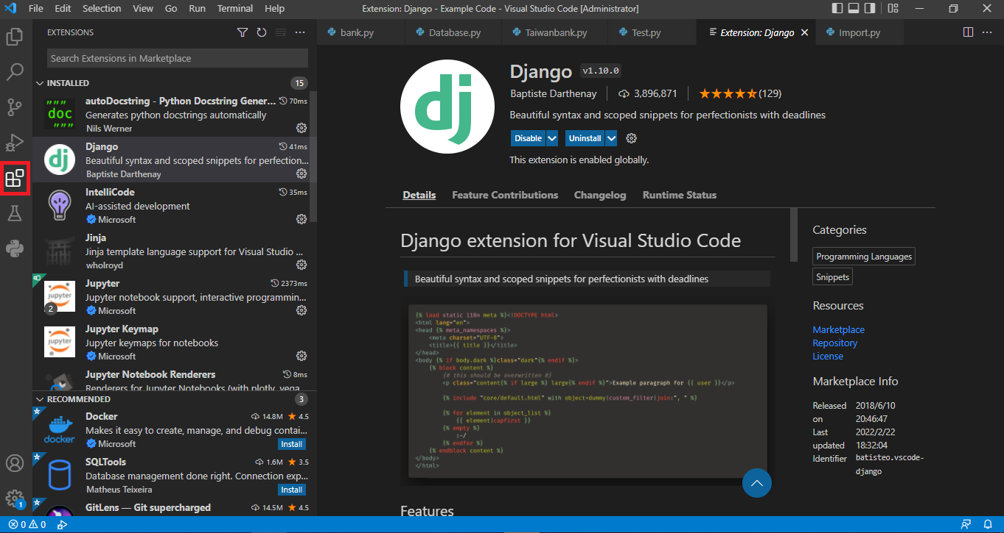
Visual Studio Code (Extensions)

Slide 13
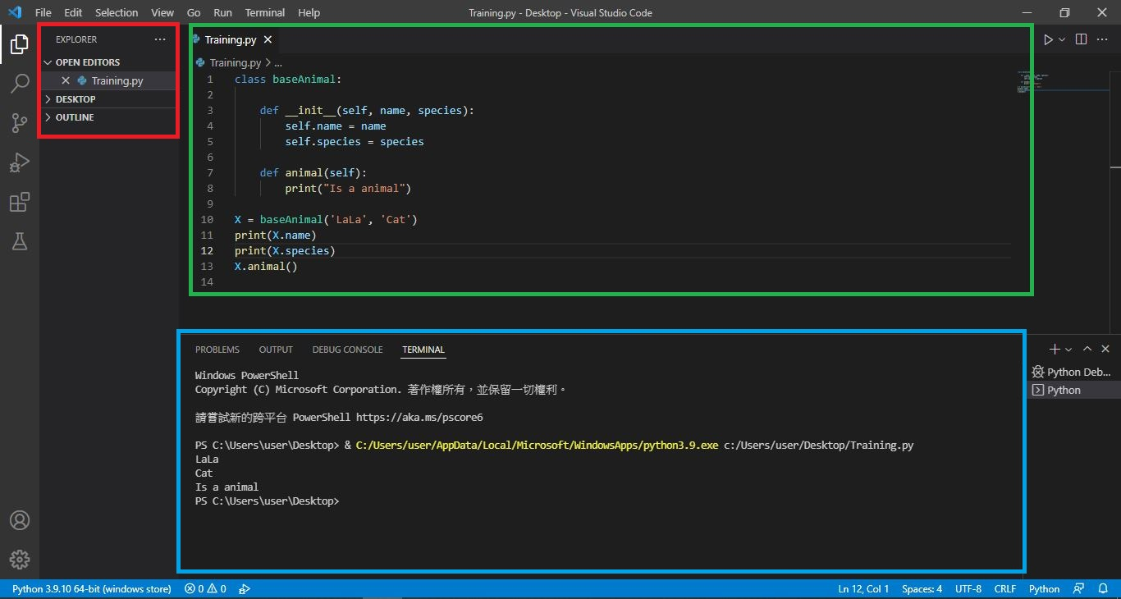
Visual Studio Code
Explorer
Code
Console

Slide 14
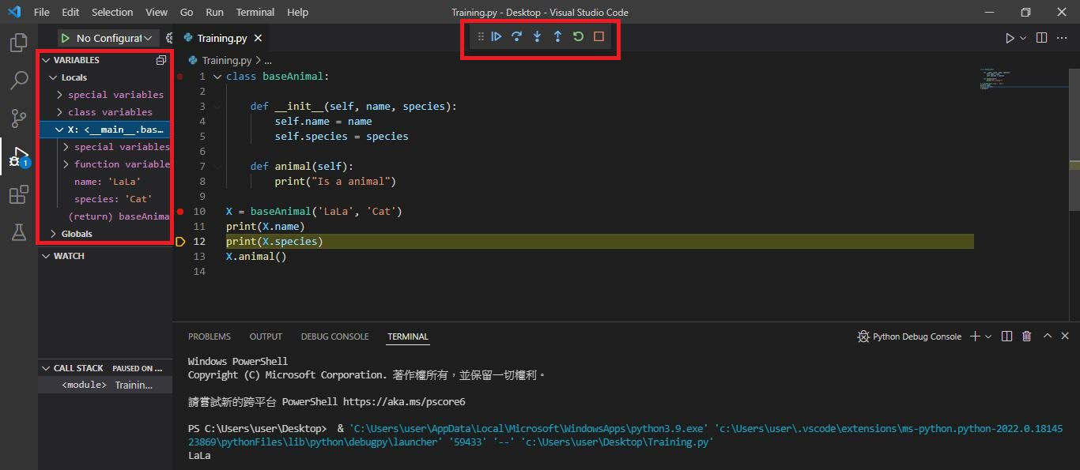
Visual Studio Code
Debug mode
By step to execute
View all of the variables

Slide 15
Package Install

Slide 16
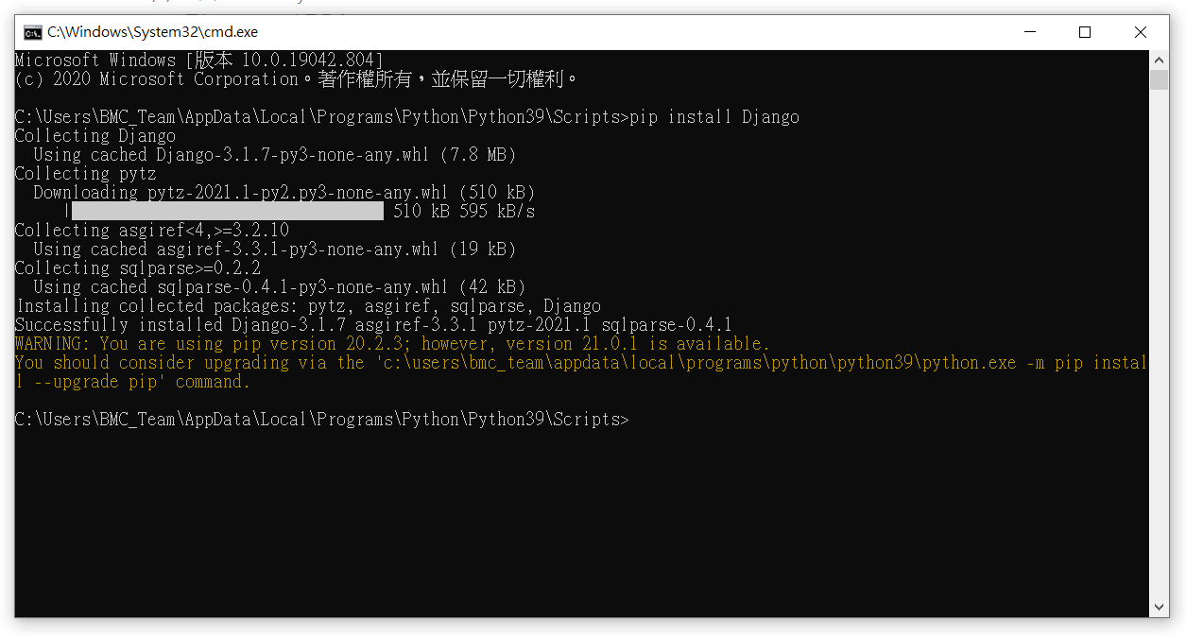
Package Install (Python)
$ pip install $PackageName

Slide 17
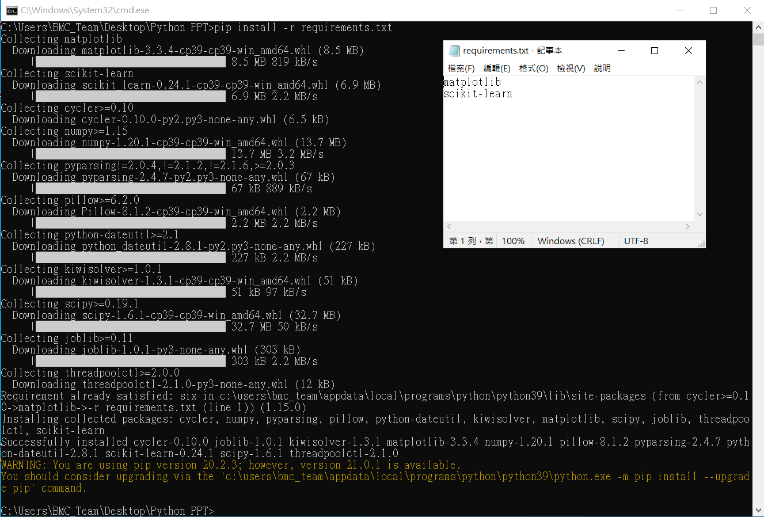
Package Install (requirements.txt)
$ pip install -r requirements.txt

Slide 18
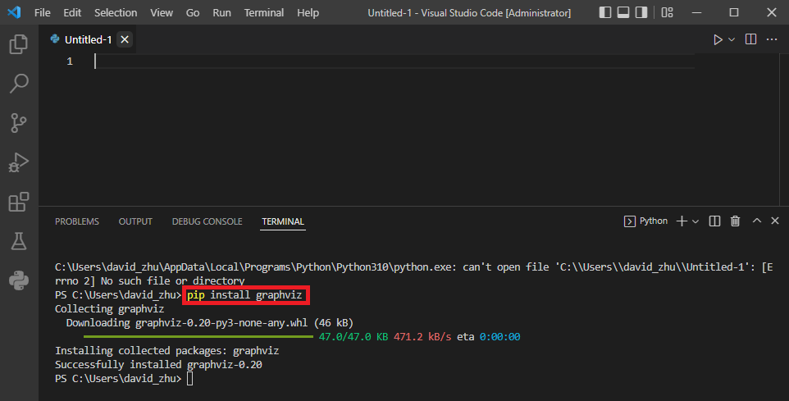
Package Install (VS code)
$ pip install $PackageName

Slide 19
Common

Slide 20
Common(Keyword)
False | class | finally | is | Return
None | continue | for | lambda | Try
True | def | from | nonlocal | While
and | del | global | not | With
as | elif | if | or | Yield
assert | else | import | Pass
break | except | in | Raise
* Don’t used to name the variable

Slide 21
Common(Built-in functions)
abs() | delattr() | hash() | memoryview() | set()
all() | dict() | help() | min() | setattr()
any() | dir() | hex() | next() | slice()
ascii() | divmod() | id() | object() | sorted()
bin() | enumerate() | input() | oct() | staticmethod()
bool() | eval() | int() | open() | str()
breakpoint() | exec() | isinstance() | ord() | sum()
bytearray() | filter() | issubclass() | pow() | super()
bytes() | float() | iter() | print() | tuple()
callable() | format() | len() | property() | type()
chr() | frozenset() | list() | range() | vars()
classmethod() | getattr() | locals() | repr() | zip()
compile() | globals() | map() | reversed() | __import__()
complex() | hasattr() | max() | round()
* Don’t used to name the function

Slide 22
Common(Variable name)
1. First word should be English or _.
2. After the first word that can used English, numeric or _ .

Slide 23
Data Type

Slide 24
Data Type
Numeric type
Integer (int)
Floating-point (float)
Boolean (bool)
Text type
String (str)
3. Sequence type
List[]
Tuple()
Dict{}
Set{}

Slide 25

Data Type (Integer)
x = 1 # Assign 1 to x print(x) # print x print(type(x)) # print x type

Slide 26

Data Type (Float)
x = 1.5 # Assign 1.5 to x print(x) # print x print(type(x)) # print x type

Slide 27
Data Type(Arithmetic operator)
+ | 加 | a+b
- | 減 | a-b
* | 乘 | a*b
/ | 除 | a/b
% | 取餘數 | a%b

Slide 28
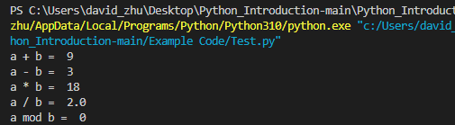
Data Type(Arithmetic operator)
a = 6 # Assign 6 to a
b = 3 # Assign 3 to b
print("a + b = ", a + b) # a + b
print("a - b = ", a - b) # a - b
print("a * b = ", a * b) # a * b
print("a / b = ", a / b) # a / b
print("a mod b = ", a % b) # a mod b

Slide 29
Data Type(Comparison operator)
< | 小於 | a < b
> | 大於 | a > b
<= | 小於等於 | a <= b
>= | 大於等於 | a >= b
== | 相等 | a == b
!= | 不相等 | a != b
* It will return the Boolean type

Slide 30
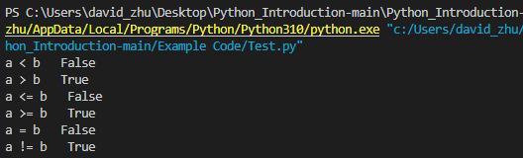
Data Type(Comparison operator)
a = 6 # Assign 6 to a
b = 3 # Assign 3 to b
print("a < b ", a < b) # a < b ?
print("a > b ", a > b) # a > b ?
print("a <= b ", a <= b) # a <= b ?
print("a >= b ", a >= b) # a >= b ?
print("a = b ", a == b) # a = b ?
print("a != b ", a != b) # a != b ?

Slide 31

Data Type (Str)
x = "string " # Assign “string” to x
print(x) # print x
print(type(x)) # print x type

Slide 32
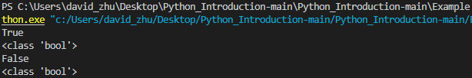
Data Type (bool)
x = True # Assign “True” to bool x
y = False # Assign “False” to bool y
print(x) # print x
print(type(x)) # print x type
print(y) # print x
print(type(y)) # print x type

Slide 33
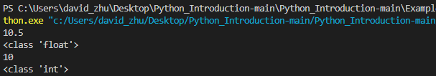
Data Type (Float transfer to Integer)
x = 10.5 # float type
print(x) # print x
print(type(x)) # print x type
x = int(x) # float transfer to integer
print(x) # print x
print(type(x)) # print x type

Slide 34
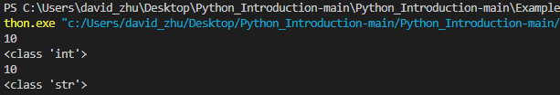
Data Type (Integer transfer to String)
x = 10 # Integer type
print(x) # print x
print(type(x)) # print x type
x = str(x) # Integer transfer to string
print(x) # print x
print(type(x)) # print x type

Slide 35
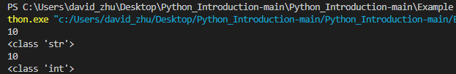
Data Type (String transfer to Integer)
x = "10" # String type of the Integer
print(x) # print x
print(type(x)) # print x type
x = int(x) # String transfer to Integer
print(x) # print x
print(type(x)) # print x type

Slide 36
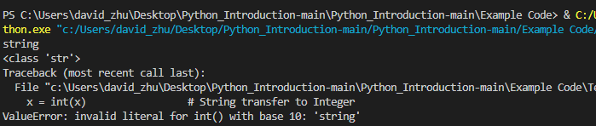
Data Type (String transfer to Integer)
x = "string" # String type
print(x) # print x
print(type(x)) # print x type
x = int(x) # String transfer to Integer
print(x) # print x
print(type(x)) # print x type
* Only String type of the Integer can be transfer

Slide 37
Data Structure

Slide 38
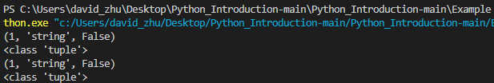
Data Structure (Tuple)
x = 1 ,"string", False #Assign 1, “string”, False to bool x
y = ( 1 ,"string", False) #Assign (1, “string”, False) to tuple y
print(x) #print x
print(type(x)) #print x type
print(y) #print y
print(type(y)) #print y type

Slide 39
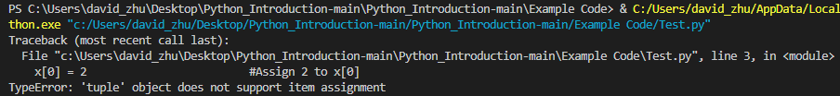
Data Structure (Tuple)
x = ( 1 ,"string", False) #Assign (1, “string”, False) to tuple x
x[0] = 2 #Assign 2 to x[0]
print(x) #print x
print(type(x)) #print x type
* Tuple object doesn’t support item assignment

Slide 40

Data Structure (List)
x = [ 1 ,"string", False] #Assign [1, “string”, False] to list x
print(x) #print x
print(type(x)) #print x type

Slide 41

Data Structure (List)
x = [ 1 ,"string", False] #Assign (1, “string”, False) to tuple x
print(x) #print(x)
x[0] = 2 #Assign 2 to x[0]
print(x) #print x
print(type(x)) #print x type
* List object support item assignment

Slide 42

Data Structure (list.append)
x = [ 1 ,"string", False] #Assign [1, “string”,False] to list x
print(x) #print x
print(type(x)) #print x type
x.append("Python") #add “python” to list x
print(x) #print x
* append() function add to end of the List

Slide 43

Data Structure (list.insert)
x = [ 1 ,"string", False] #Assign [ 1 ,"string", False] to list x
print(x) #print x
print(type(x)) #print x type
x.insert(0, "python") #insert “python” to list x[0]
print(x) #print x

Slide 44

Data Structure (list.remove)
x = [ 1 ,"string", False] #Assign [ 1 ,"string", False] to list x
print(x) #print x
print(type(x)) #print x type
x.remove("string") #remove from list x
print(x) #print x

Slide 45

Data Structure (Two-dimensional List)
list1 = [[1,2,3], # Assign 1~9 to two-dimensional list
[4,5,6],
[7,8,9]]
print(list1[1][0]) # Print list[1][0]
print(list1[1][1]) # Print list[1][1]

Slide 46
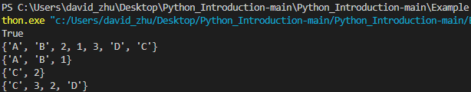
Data Structure (Set)
set1 = {"A","B","C",1 ,2}
set2 = {"A","B","D",1 ,3}
print("A" in set1) # "A" in set1 or not
print(set1 | set2) # Union (聯集)
print(set1 & set2) # Intersection (交集)
print(set1 - set2) # Subtraction (差集)
print(set1 ^ set2) # XOR (互斥或)

Slide 47
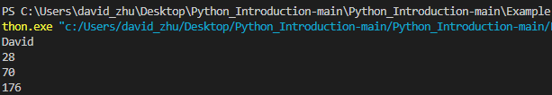
Data Structure (Dict)
dict = {"Name" : "David", "Age" : 28, "Weight" : 70, "Height" : 176}
print(dict["Name"])
print(dict["Age"])
print(dict["Weight"])
print(dict["Height"])

Slide 48

Data Structure (dict.clean())
dict = {"Name" : "David", "Age" : 28, "Weight" : 70, "Height" : 176}
print(dict)
dict.clear()
print(dict)

Slide 49

Data Structure (dict.copy())
dict = {"Name" : "David", "Age" : 28, "Weight" : 70, "Height" : 176}
dict2 = dict.copy()
print("dict : ", dict)
print("dict2 : ", dict2)

Slide 50

Data Structure (dict.get())
dict = {"Name" : "David", "Age" : 28, "Weight" : 70, "Height" : 176}
print(dict.get("Name"))
print(dict.get("Age"))

Slide 51

Data Structure (dict compare)
dict = {"Name" : "David", "Age" : 28, "Weight" : 70, "Height" : 176}
dict2 = {"Name" : "Ricky", "Age" : 28, "Weight" : 70, "Height" : 176}
print("Compare Result", dict == dict2)
dict2["Name" ] = "David"
print("Compare Result", dict == dict2)

Slide 52
Flow control

Slide 53
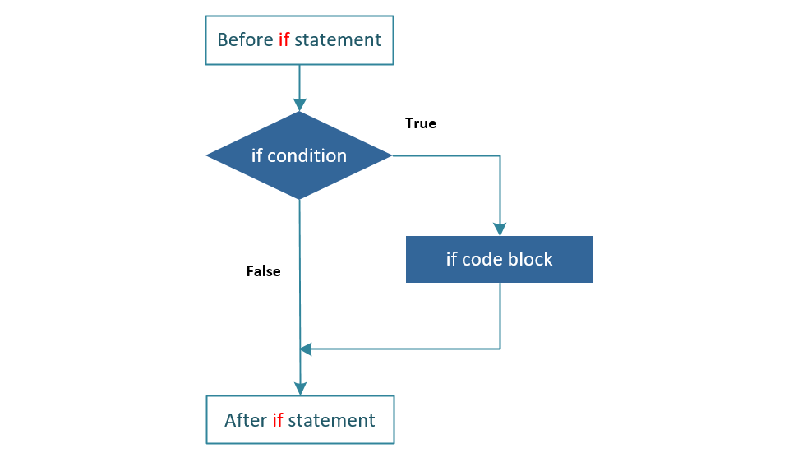
Flow control (If_else)

Slide 54
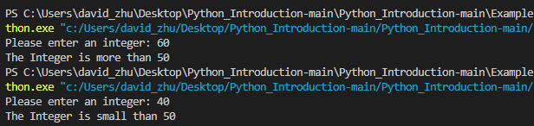
Flow control (If_else)
x = int(input("Please enter an integer: ")) # Assign input number to x
if x < 50:
print("The Integer is small than 50") # If x < 50, print
elif x > 50:
print("The Integer is more than 50") # If x > 50, print
else:
print("The Integer is 50") # If not meets above, print

Slide 55
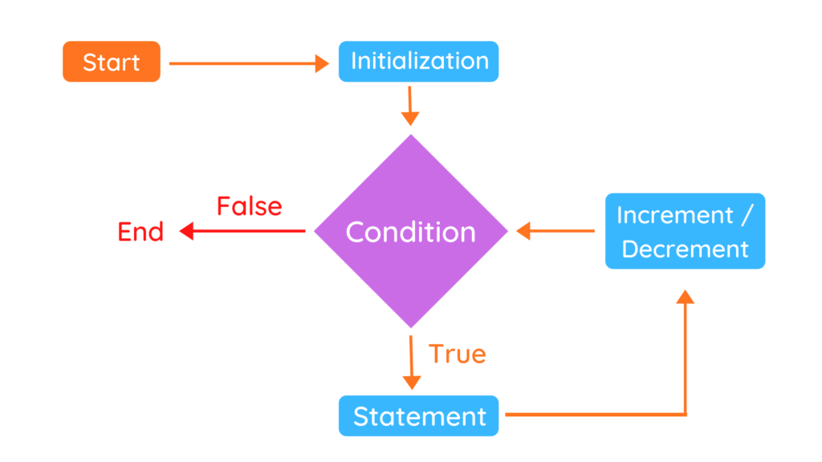
Flow control (for_loop)

Slide 56

Flow control (for_loop)
words = ["Python", "Java", "C++"] # Assign List[] to words
for w in words:
print(w, len(w)) # Print w in words[] and count it.

Slide 57
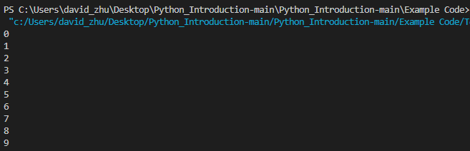
Flow control (for_range)
for i in range(10):
print(i) # Print i from 0 to 9

Slide 58
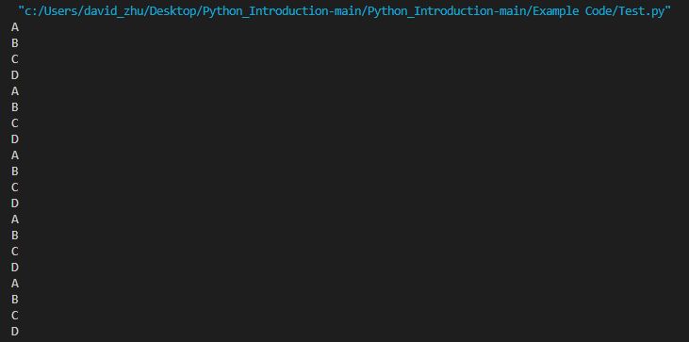
Flow control (nested_loops)
words = ["A", "B", "C", "D"] #Assign “A”, “B”, “C”, “D” to words
for i in range(5):
for j in words:
print(j) #Print j

Slide 59
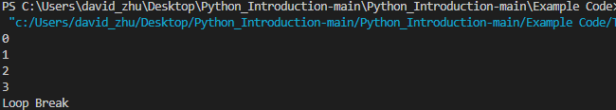
Flow control (break)
for i in range(5):
print(i) #Print I
if i == 3: #if i = 3
print("Loop Break") #print “Loop Break” then break loop
break

Slide 60
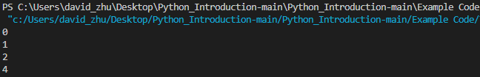
Flow control (continue)
for i in range(5):
if i == 3: #if i = 3
continue #Bypass then continue loop
print(i) #Print i

Slide 61
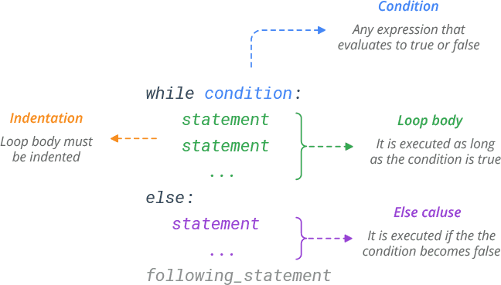
Flow control (while_loop)

Slide 62
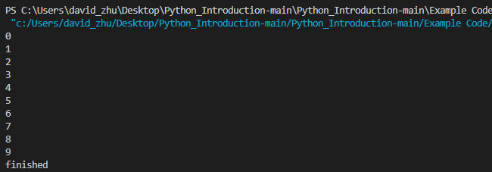
Flow control (while_loop)
i = 0 # assign 0 to i
while i < 10: # if i < 10 is true
print(i) # print i
i += 1 # I + 1
else:
print("finished") # if i < 10 is false

Slide 63
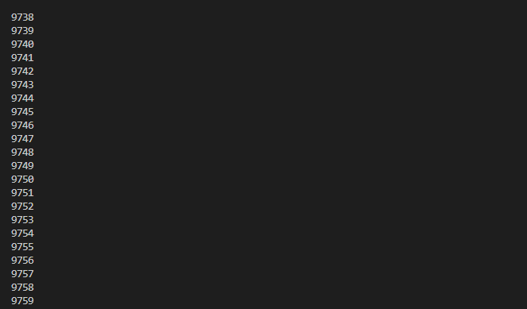
Flow control (infinite_loop)
i = 0 # assign 0 to i
while True: # infinite_loop
print(i) # print i
i += 1 # I + 1
else:
print("finished") # if i < 10 is false

Slide 64
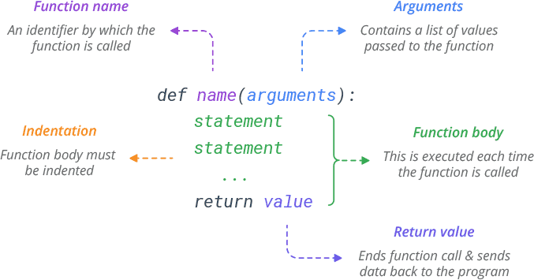
Flow control (function)

Slide 65
Flow control (function)
def example(n): # function example()
n+=5 # n = n + 5
print(n) # print n
example(10) # call function example()

Slide 66
Flow control (return)
def example(n): # function example()
n+=5 # n = n + 5
return n # return n to this function
x = example(10) # assign to x
print(x)

Slide 67

Flow control (return & print)
def example(n): # function example()
n+=5 # n = n + 5
x = 100
print(n) # print n on console only
return x # return x to this function
result = example(10) # assign to result
print(result + 100)
Return is return the result to function
Print is print the result on console only

Slide 68
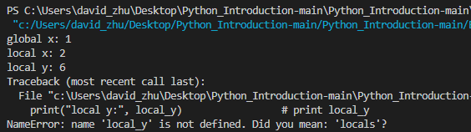
Flow control (global/local variable)
gobal_x = 1 # Assign 1 to gobal_x
def example(): # Function example()
local_x = 2 # Assign 2 to local_x
local_y = 6 # Assign 6 to local_y
print("global x:",gobal_x) # print global_x
print("local x:",local_x) # print local_x
print("local y:", local_y) # print local_y
example() # call function example()
print("local y:", local_y) # print local_y

Slide 69
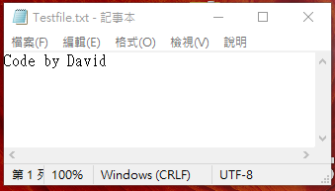
Flow control (file write)
file = open("Testfile.txt","w") # Open file
file.write("Code by David") # Write file
file.close # stream close

Slide 70

Flow control (file read)
file = open("Testfile.txt", "r") # Open file
print(file.read()) # Read file
file.close # stream close

Slide 71

Flow control (with as)
txtfile= "Code by David.\n Hello ASUS"
with open("Testfile.txt","w") as file: # Open file and stream close
file.write(txtfile) # Write file
with open("Testfile.txt","r") as file:
print(file.read()) # Read file

Slide 72
Module

Slide 73

Module(Import)
#util.py
def example1():
print("example1 function")
def example2():
print("example2 function")
#Demo.py
Import util
util.example1()
util.example2()

Slide 74
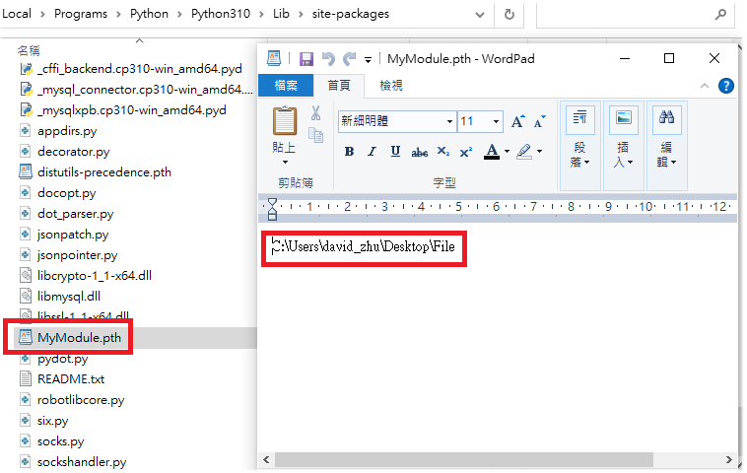
Module (Different Folder Import)
Add Project package path as below with .pth file for python to Identify your package module
*AppData\Local\Programs\Python\Python310\Lib\site-packages

Slide 75
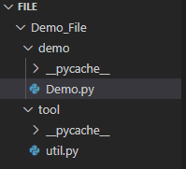
Module(Different Folder Import)
#util.py
def example1():
print("example1 function")
def example2():
print("example2 function")
#Demo.py
from Demo_File.tool import util
util.example1()
util.example2()

Slide 76
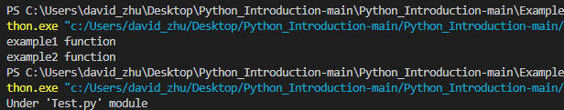
Module (if __name__ == "__main__":)
#Test.py
def example1():
print("example1 function")
def example2():
print("example2 function")
if __name__ == "__main__":
print("Under 'Test.py' module")
#import.py
import Test
Test.example1()
Test.example2()

Slide 77
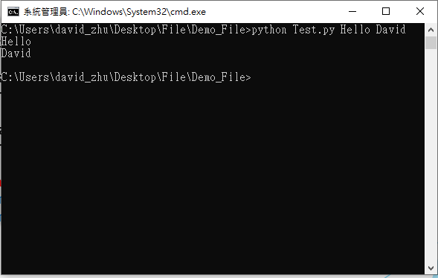
Module (Library modules)
#temp.py
import sys
def example1(n):
print(n)
def example2(m):
print(m)
if __name__ == "__main__":
example1(str(sys.argv[1]))
example2(str(sys.argv[2]))

Slide 78
Exception

Slide 79
Exception (Error Type)
# Exception (checking)
# EX : ValueError, NameError, TypeError
# Runtime Exception (unchecking)
# EX : OS crash, HW component error …….
# Can’t be catch by python.

Slide 80
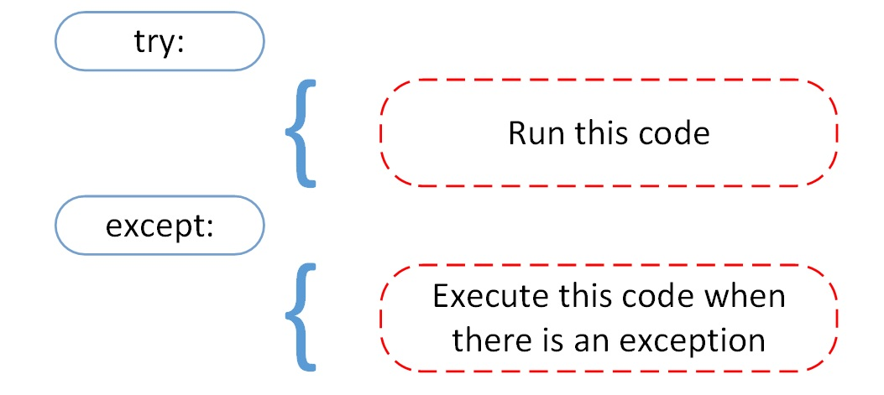
Exception (Error Type)

Slide 81
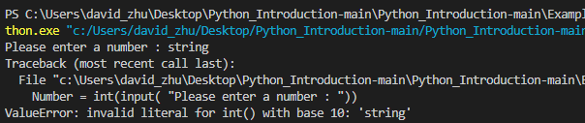
Exception (Error)
# Exception error
Number = int(input( "Please enter a number : "))

Slide 82
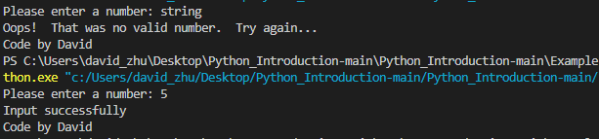
Exception (try_catch)
# Exception error
try:
Number = int(input("Please enter a number: "))
except ValueError:
print("Oops! That was no valid number. Try again...")
else:
print("Input successfully")
finally:
print("Code by David")

Slide 83
Object-oriented Programming

Slide 84
Object-oriented Programming
Encapsulation 封裝 : 一種將函式介面的實作細節部份包裝、隱藏起來的方法，它也是一種防止外界呼叫端，去存取物件內部實作細節的手段。
Inheritance 繼承 : 繼承可以使得子類具有父類別別的各種屬性和方法，而不需要再次編寫相同的代碼。
Polymorphism 多型 : 指為不同資料類型的實體提供統一的介面，透過不同的實例化物件來呼叫相同的方法可以達到不同的實作方式。

Slide 85
Class (類別)
# Class sample
class baseClassName:
<statement-1>
.
.
.
<statement-N>

Slide 86

Class (類別)
# Animal Class
class baseAnimal: # baseAnimal class
string = "Is not a animal"
def animal(self):
print("Is a animal")
X = baseAnimal() # 實例化
print(X.string) # Call string
X.animal() # Call animal method

Slide 87
Class (匿名物件)
# Animal Class
class baseAnimal: # baseAnimal class
string = "Is not a animal"
def animal(self):
print("Is a animal")
print(baseAnimal().string) # Call string
baseAnimal().animal() # Call animal method
#以匿名物件的方式省略實例化的動作來使用物件內的方法

Slide 88

Class ( __init__ 建構子)
# Animal Class
class baseAnimal:
def __init__(self, name, species):
self.name = name
self.species = species
def animal(self):
print("Is a animal")
X = baseAnimal('LaLa', 'Cat')
print(X.name)
print(X.species)
X.animal()
#__init__ 作為設定物件初始化資料使用
#__init__ 附帶宣告的變數會成為實例化時需要的參數

Slide 89

Encapsulation (封裝)
# Animal Class
class baseAnimal:
def __init__(self, name, species):
self.__name = name
self.__species = species
def animal(self):
print("Is a animal")
X = baseAnimal('LaLa', 'Cat')
print(X.__name)
print(X.__species)
X.animal()
#透過封裝防止內部資料直接被外部呼叫

Slide 90

Encapsulation (封裝)
# Animal Class
class baseAnimal:
def __init__(self, name, species):
self.__name = name
self.__species = species
def getAnimalName(getname):
return getname.__name
def getAnimalSpecies(getspecies):
return getspecies.__species
X = baseAnimal("LaLa","Cat")
print(X.getAnimalName())
print(X.getAnimalSpecies())
#透過 Method 回傳被封裝的資料

Slide 91
Inheritance (繼承)
# Inheritance
class DerivedClassName(BaseClassName):
<statement-1>
.
.
.
<statement-N>

Slide 92

Inheritance (繼承)
# Animal Class
class baseAnimal:
def __init__(self, name, species):
self.__name = name
self.__species = species
def getAnimalName(self):
return self.__name
def getAnimalSpecies(self):
return self.__species
class cat(baseAnimal):
def update(self):
return "喵喵叫"
X = cat("LaLa","Cat")
print(X.getAnimalName()) #透過繼承取得父類別 Method
print(X.getAnimalSpecies())
print(X.update()) #依然可使用自己類別的 Method

Slide 93
Inheritance (多重繼承)
# Animal Class
class baseAnimal:
def __init__(self, name):
self.__name = name
def getAnimalName(self):
return self.__name
class baseAnimal2:
def __init__(self, species):
self.__species = species
def getAnimalSpecies(self):
return self.__species
class cat(baseAnimal, baseAnimal2):
def __init__(self, name, specie):
baseAnimal.__init__(self,name)
baseAnimal2.__init__(self,specie)
def update(self):
return "喵喵叫"
X = cat("LaLa","Cat")
print(X.getAnimalName()) #透過多重繼承取得兩個父類別 Method
print(X.getAnimalSpecies())
print(X.update()) #多重繼承後依然可使用自己類別的 Method

Slide 94

Inheritance (覆寫)
# Animal Class
class baseAnimal:
def __init__(self, name, species):
self.__name = name
self.__species = species
def getAnimalName(self):
return self.__name
def getAnimalSpecies(self):
return self.__species
class cat(baseAnimal):
def update(self):
return "喵喵叫"
def getAnimalSpecies(self): #以相同名稱的 Method覆寫父類別
return "我是貓咪"
X = cat("LaLa","Cat")
print(X.getAnimalName()) #透過繼承取得父類別 Method
print(X.getAnimalSpecies())
print(X.update()) #依然可使用本身類別的 Method

Slide 95
Inheritance (super ())
# Animal Class
class baseAnimal:
def __init__(self, name, species):
self.__name = name
self.__species = species
def getAnimalName(self):
return self.__name
def getAnimalSpecies(self):
return self.__species
class cat(baseAnimal):
def update(self):
return "喵喵叫"
def getAnimalSpecies(self): #以相同名稱的 Method覆寫父類別
return super().getAnimalSpecies() #以 super() 指定父類別 Method
X = cat("LaLa","Cat")
print(X.getAnimalName()) #透過繼承取得父類別 Method
print(X.getAnimalSpecies())
print(X.update()) #依然可使用自己類別的 Method

Slide 96
Abstract Method (抽象方法)
# Abstract Class
from abc import ABC, abstractmethod
class baseAnimal(ABC): #繼承於 python內建的抽象類別
@abstractmethod
def getAnimalName(getname):
pass
@abstractmethod
def getAnimalSpecies(getspecies):
pass
animal = baseAnimal()
#抽象類別無法被直接實例化

Slide 97

Abstract Method (抽象方法)
# Abstract Class
from abc import ABC, abstractmethod
class baseAnimal(ABC):
@abstractmethod
def getAnimalName(getname):
pass
@abstractmethod
def getAnimalSpecies(getspecies):
pass
class cat(baseAnimal):
def __init__(self,name,species):
self.name = name
self.species = species
def getAnimalName(self): #以相同的 Function名稱實現 overwrite
return self.name
def getAnimalSpecies(self):
return self.species
cat1 = cat("Lala","橘貓")
print(cat1.getAnimalName())
print(cat1.getAnimalSpecies())
#抽象類別需透過繼承來實現，並 overwrite 抽象方法

Slide 98

Abstract Method (抽象方法)
# Abstract Class
from abc import ABC, abstractmethod
class baseAnimal(ABC):
@abstractmethod
def getAnimalName(getname):
pass
@abstractmethod
def getAnimalSpecies(getspecies):
pass
class cat(baseAnimal):
def __init__(self,name,species):
self.name = name
self.species = species
def getAnimalName(self):
return self.name
cat1 = cat("Lala","橘貓")
#抽象類別可以強制繼承時所要實作的方法
#若沒有在繼承時將抽象類別的方法實作則會產生 error

Slide 99
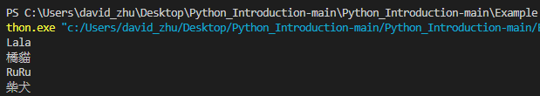
Polymorphism (多型)
# Abstract Class
from abc import ABC, abstractmethod
class baseAnimal(ABC):
@abstractmethod
def getAnimalName(getname):
pass
@abstractmethod
def getAnimalSpecies(getspecies):
pass
class cat(baseAnimal):
def __init__(self,name,species):
self.name = name
self.species = species
def getAnimalName(self):
print(self.name)
def getAnimalSpecies(self):
print(self.species)
class dog(baseAnimal):
def __init__(self,name,species):
self.name = name
self.species = species
def getAnimalName(self):
print(self.name)
def getAnimalSpecies(self):
print(self.species)
cat1 = cat("Lala","橘貓")
dog1 = dog("RuRu", "柴犬")
cat1.getAnimalName() #透過不同的實例化物件來呼叫 Method
cat1.getAnimalSpecies()
dog1.getAnimalName() #透過不同的實例化物件來呼叫 Method
dog1.getAnimalSpecies()
#透過不同的實例化物件來呼叫相同的 Method可以達到不同的實作方式

Slide 100
Reference
Python download
https://www.python.org/downloads/
Visual Studio Code download
https://code.visualstudio.com/download
Anaconda download
https://www.anaconda.com/products/individual
Python Document
https://docs.python.org/zh-tw/3/tutorial/index.html
Python Learn by example
https://www.learnbyexample.org/python-introduction/

Slide 101
Q&A

